Slide 1

PAYROLL PROCESSING APPLICATION
TEAM:
RAJARAJESWARI
HARSHAVAMSI
Page 01

Slide 2

INTRODUCTION
Employee
HR
Admin
View payroll history (salary slips)
View and update personal profile
Manage and check own attendance records
Submit and track leave applications
General access to the dashboard
Attendance tracker
Employee dashboard
Forecast hub
Access to chatbot and fetch data queries
Manage user accounts
View system-wide reports
Monitor financial transaction statuses
Access and review audit logs
General access to the dashboard
View and update own profile
Admin dashboard
Access to chatbot and fetch data queries
Manage employee records
Process and manage payroll
View and manage leave requests and history
General access to the dashboard
View and update own profile
Hr dashboard
Credit appraisal
Access to chatbot and fetch data queries
Page 02

Slide 3



TECH STACK
Springboot
React
MySQL
JWT
Java
Page 08

Slide 4
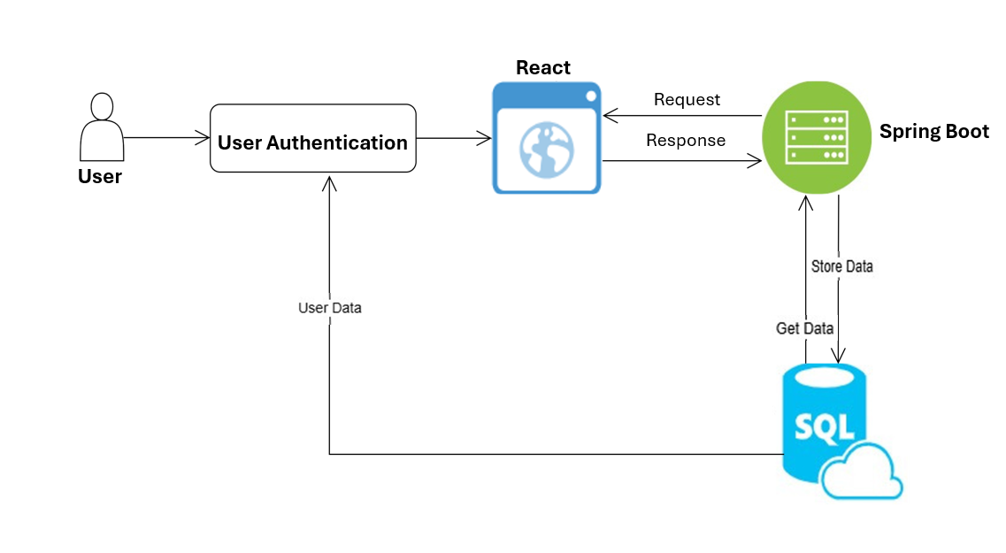
HLD Diagram
Page 03

Slide 5
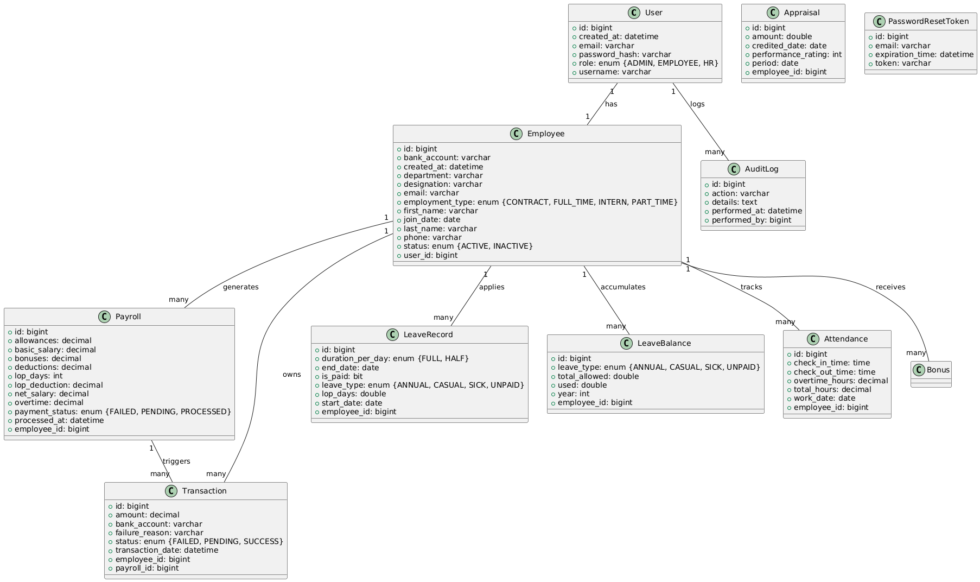
LLD - CLASS DIAGRAM
Page 04

Slide 6
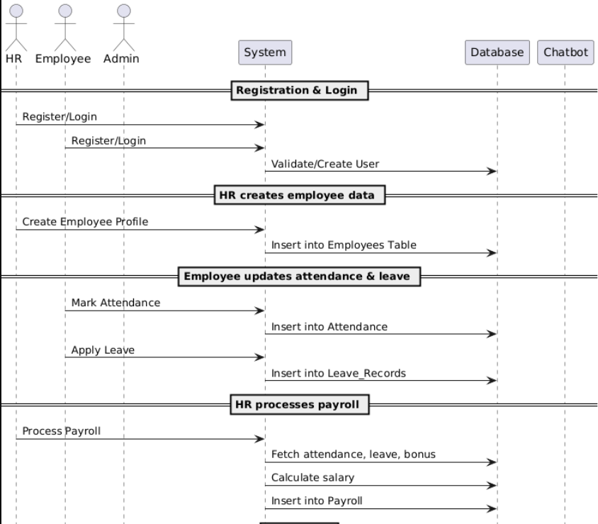
LLD - SEQUENCE DIAGRAM
Page 05

Slide 7
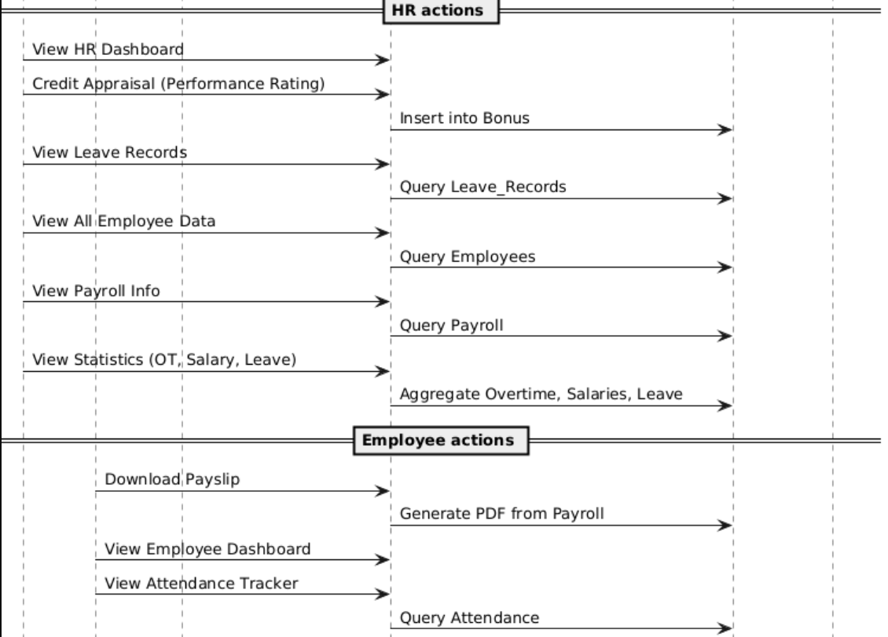
LLD - SEQUENCE DIAGRAM
Page 06

Slide 8
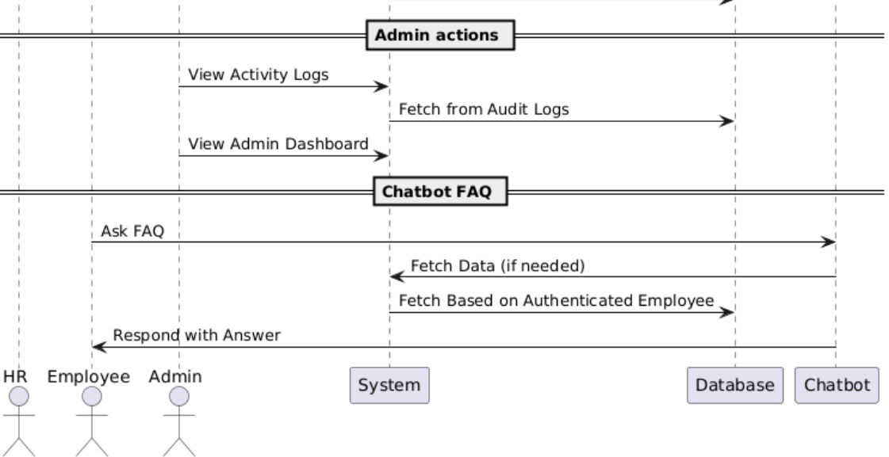
LLD - SEQUENCE DIAGRAM
Page 07

Slide 9
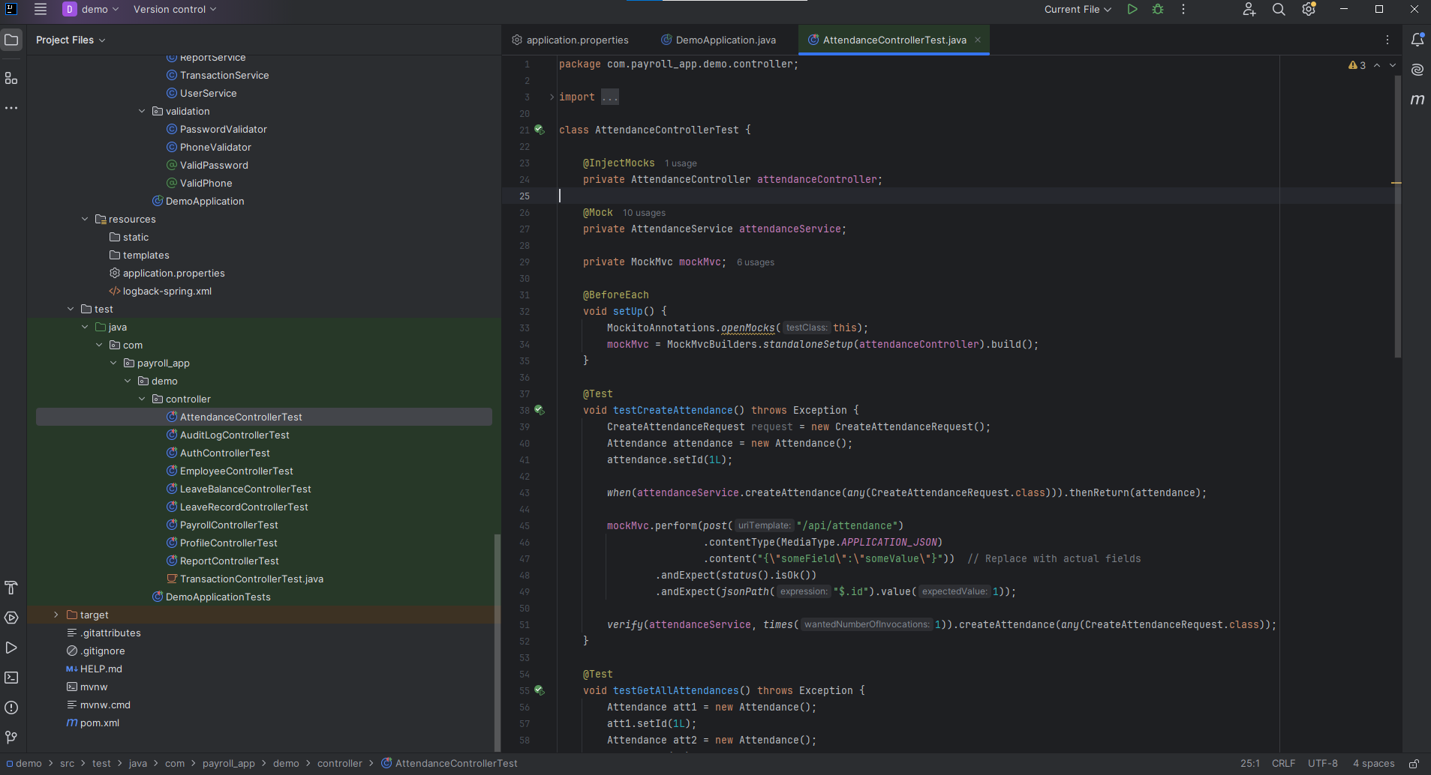
Testing
Page 08

Slide 10
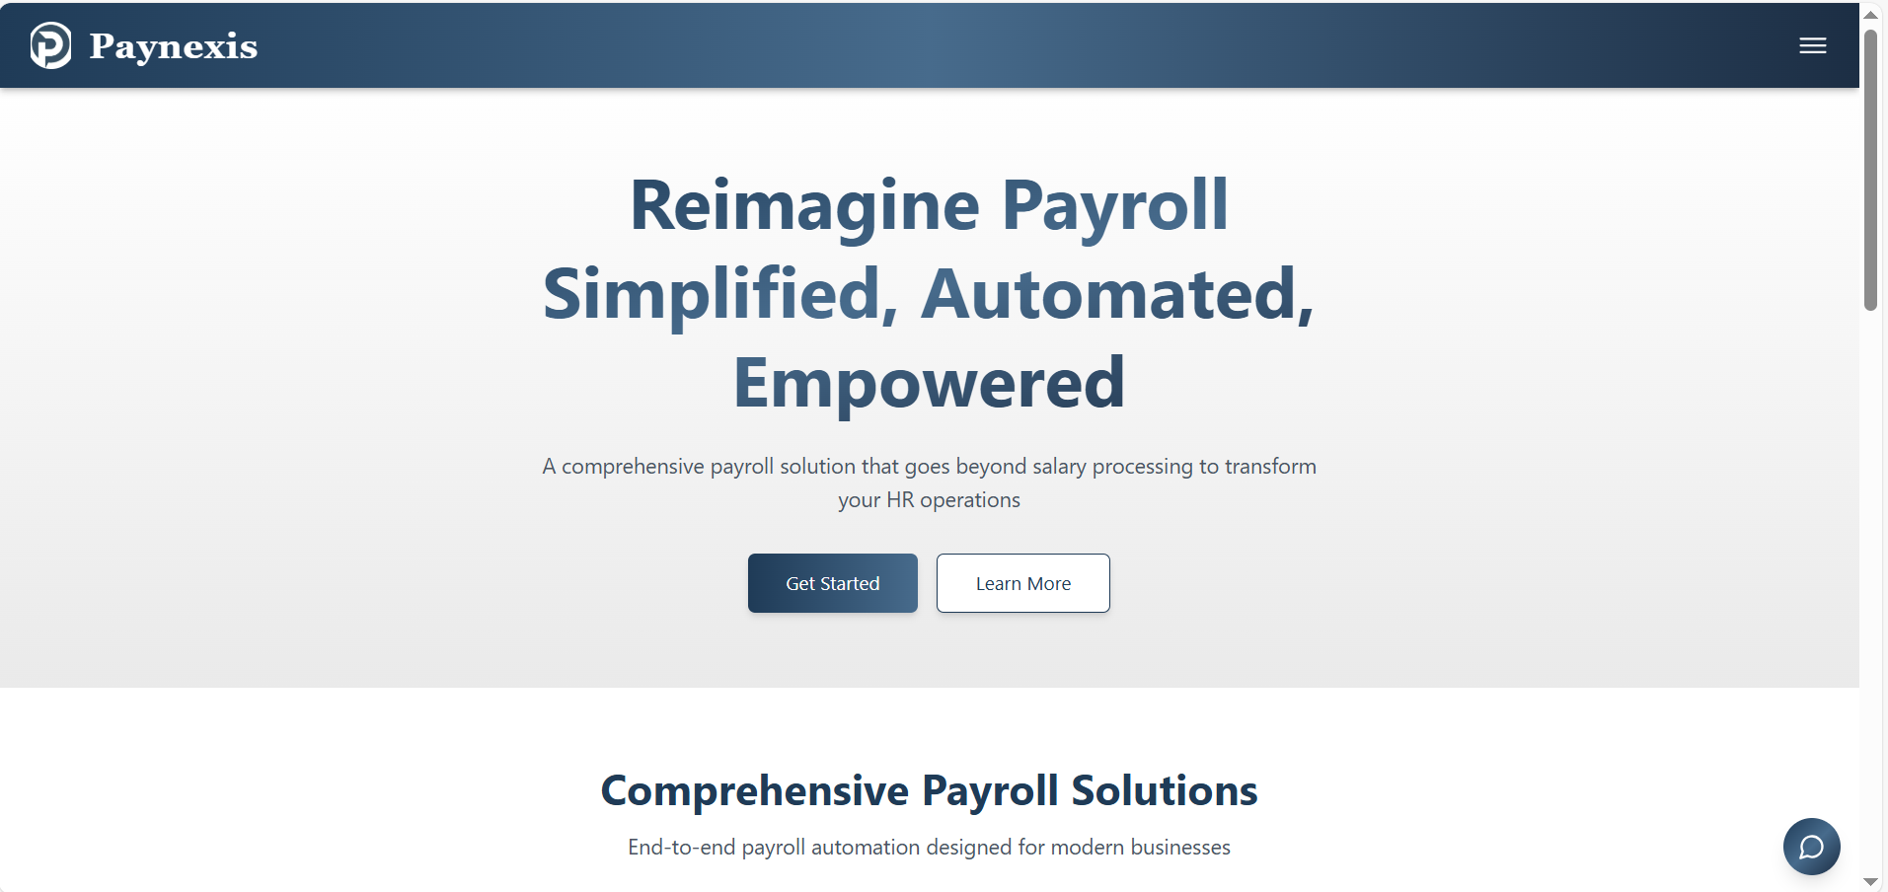
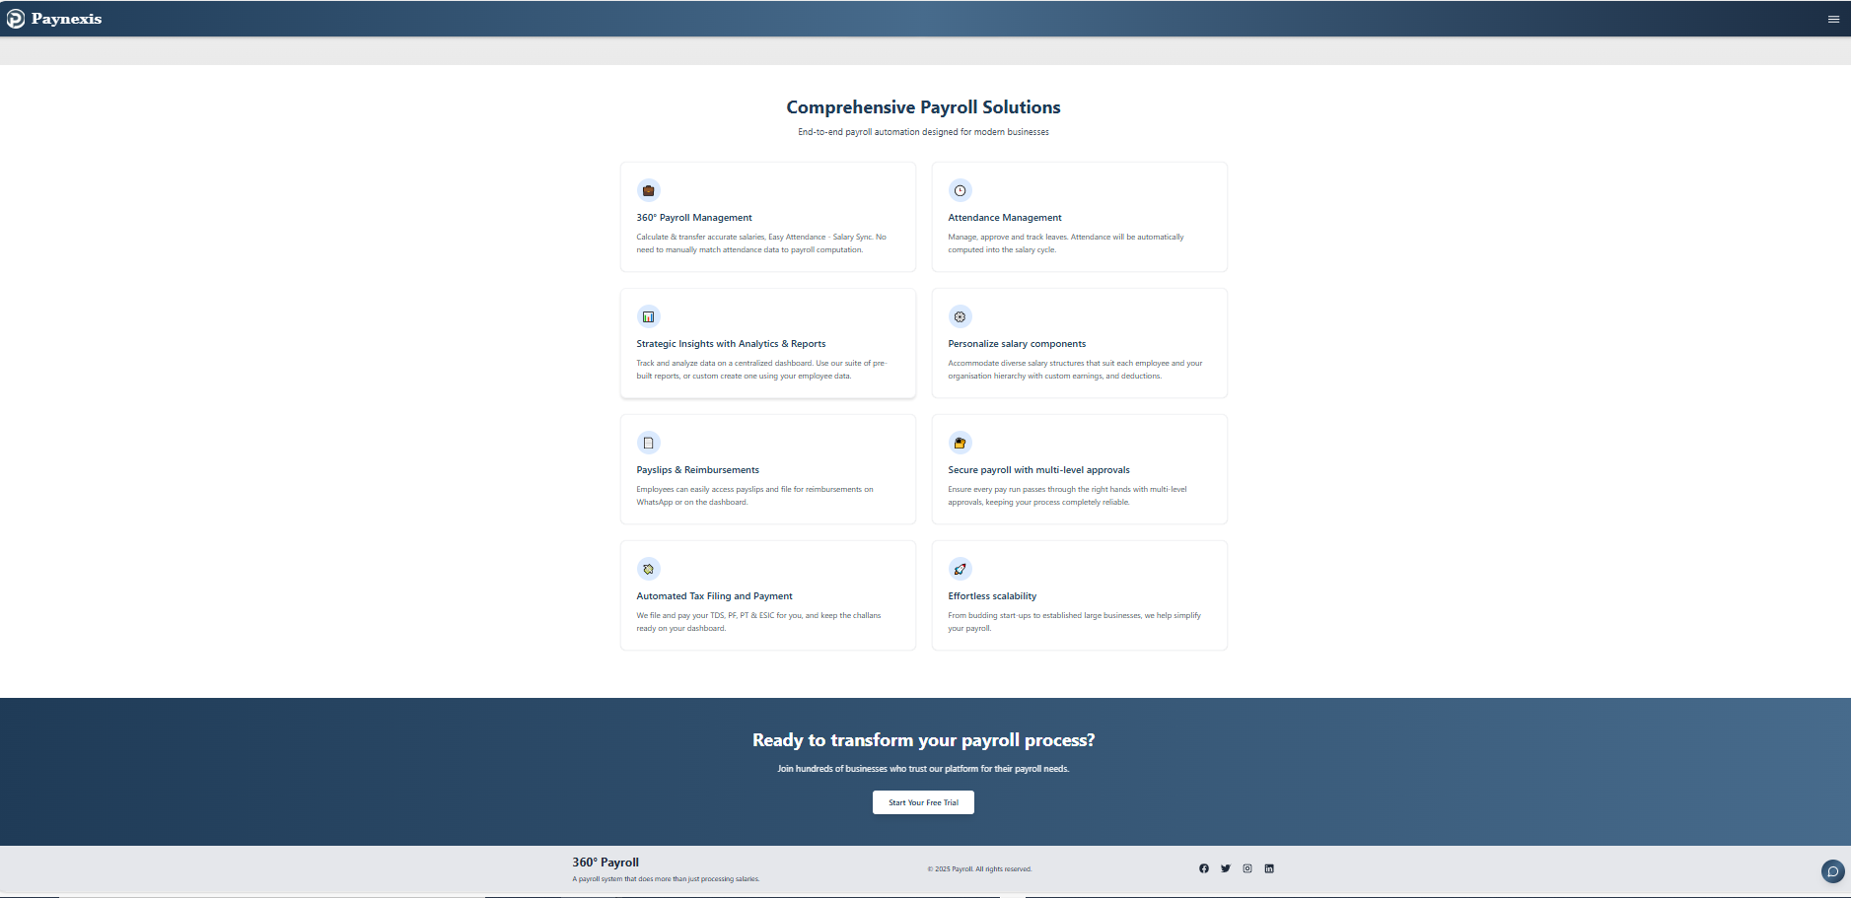
UI COMPONENTS / HOME PAGE
Page 11

Slide 11
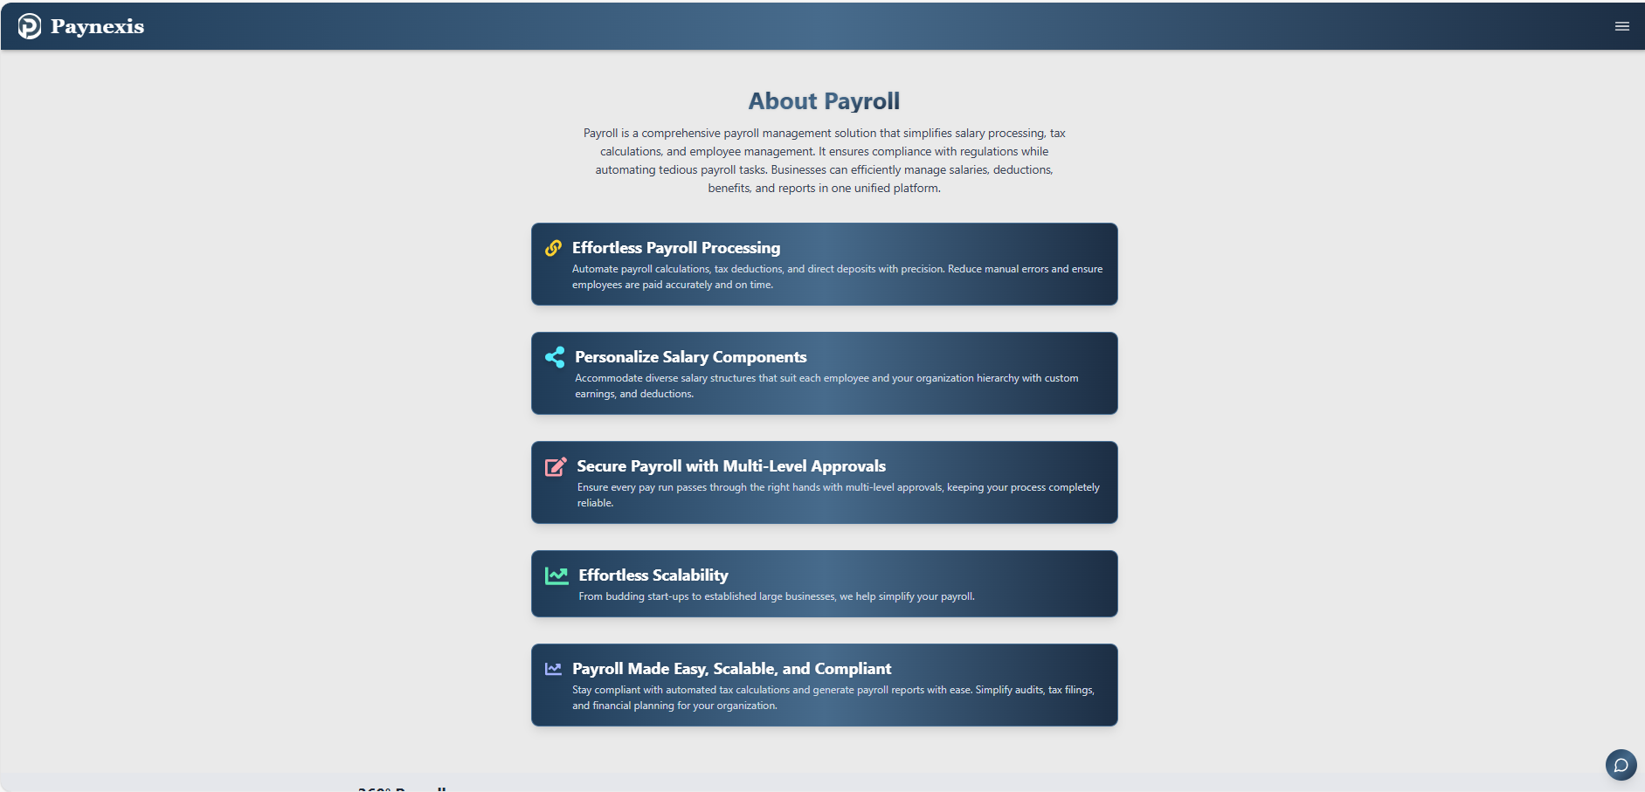
UI COMPONENTS / ABOUT PAGE
Page 11

Slide 12
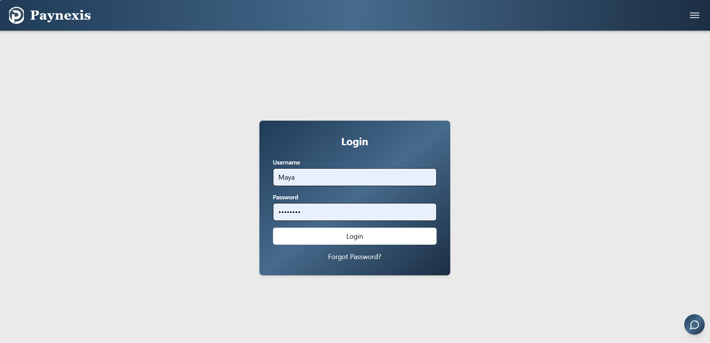
LOGIN PAGE
Page 11

Slide 13
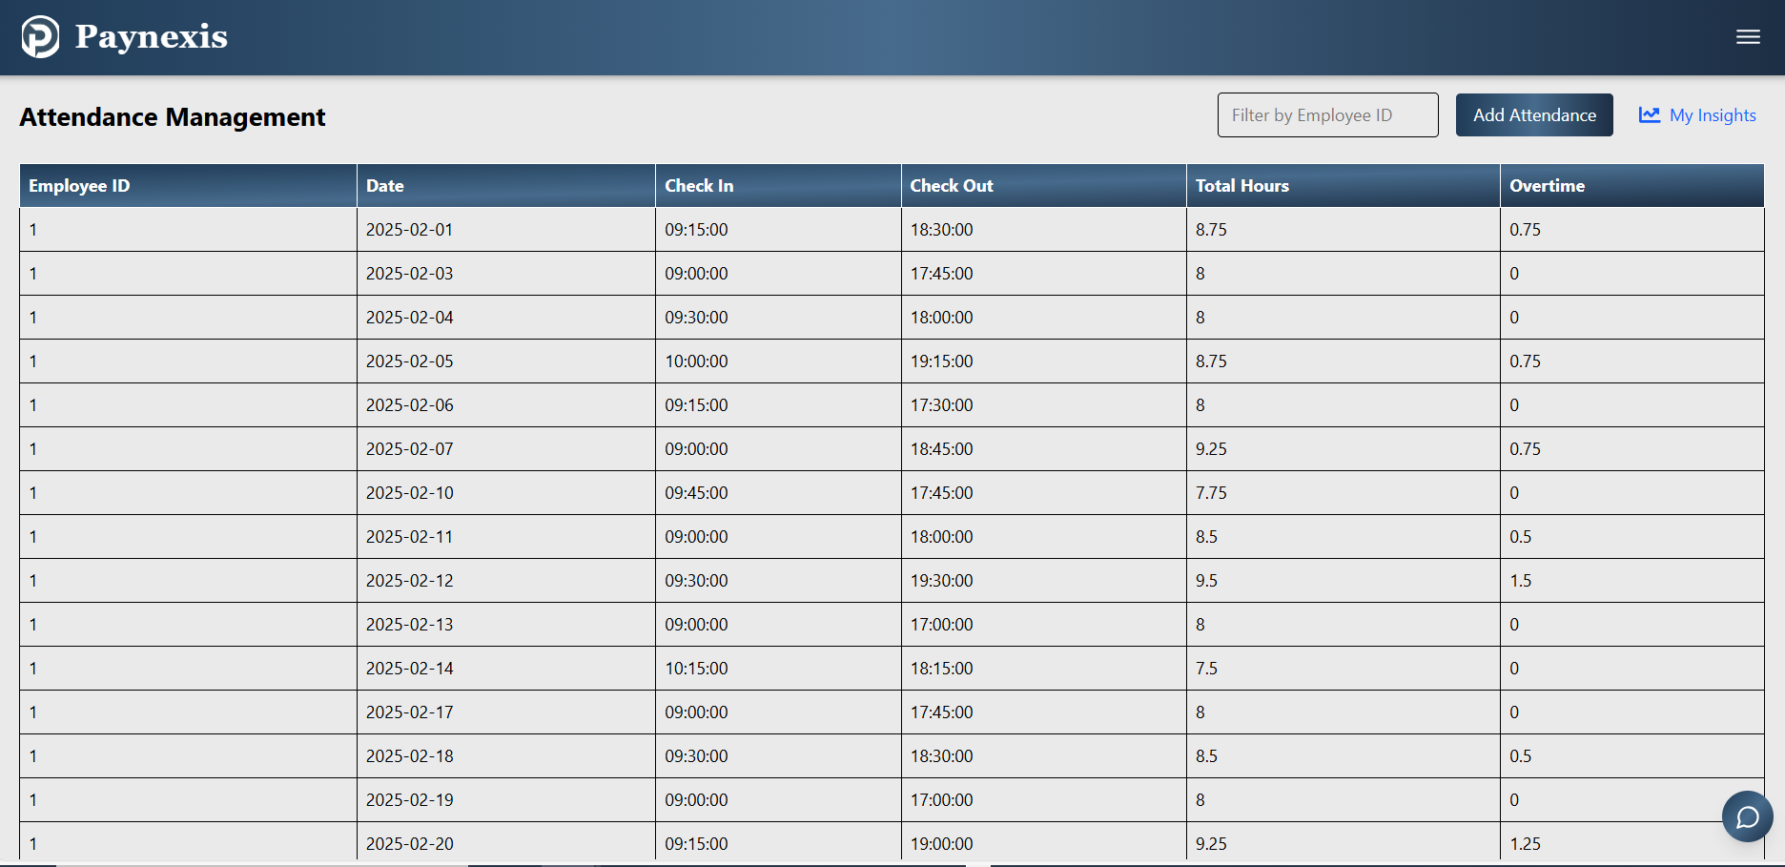
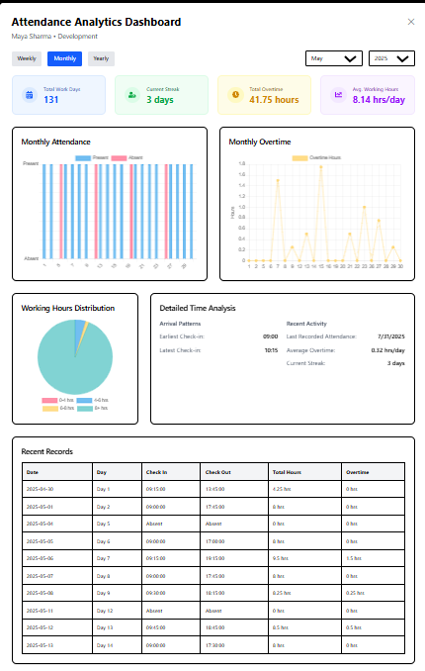
Employee Components / Attendance Management
Page 12
Employee profile

Slide 14
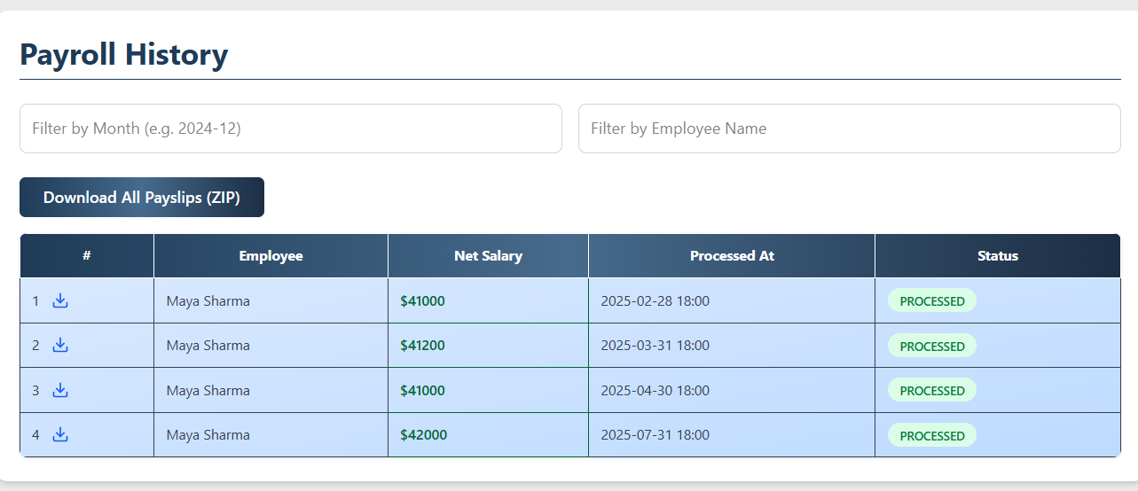
payslips
Page 12
Employee profile

Slide 15
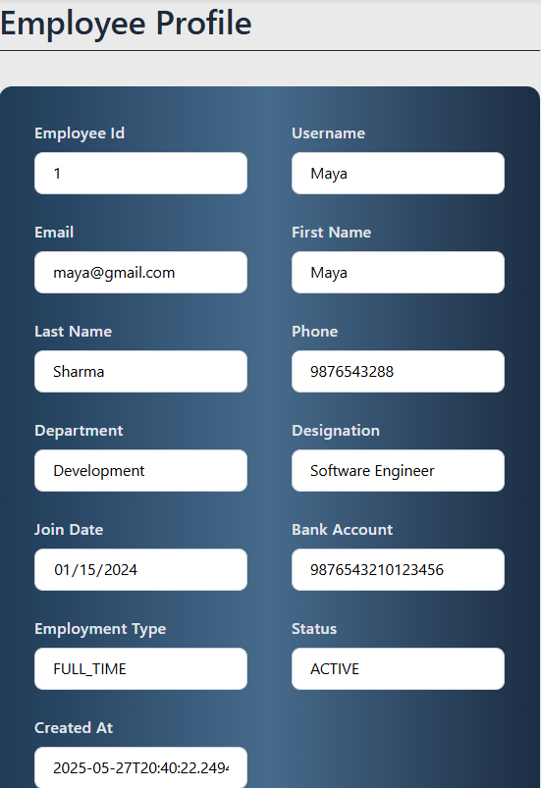
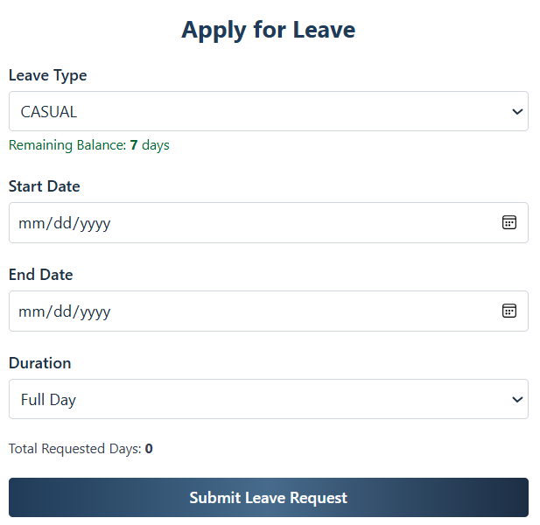
Applying leave
Employee profile
Page 12

Slide 16
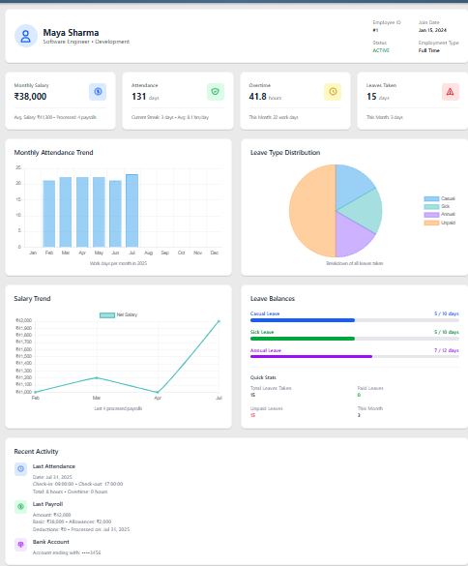
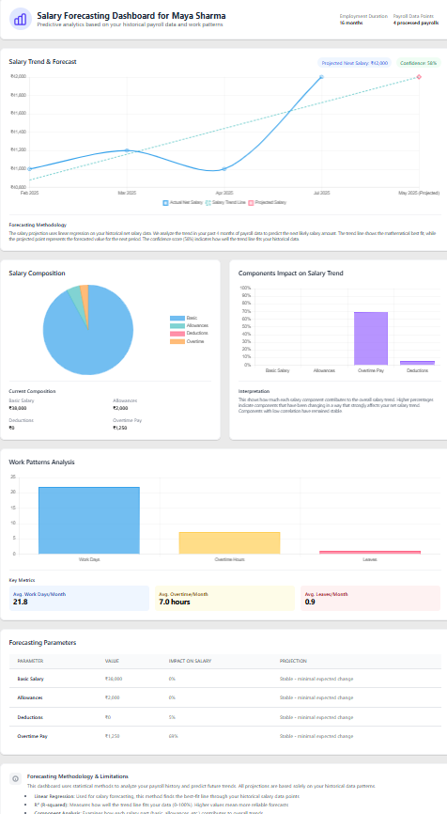
Employee Dashboard
Forecast Hub
Page 12
Employee profile

Slide 17
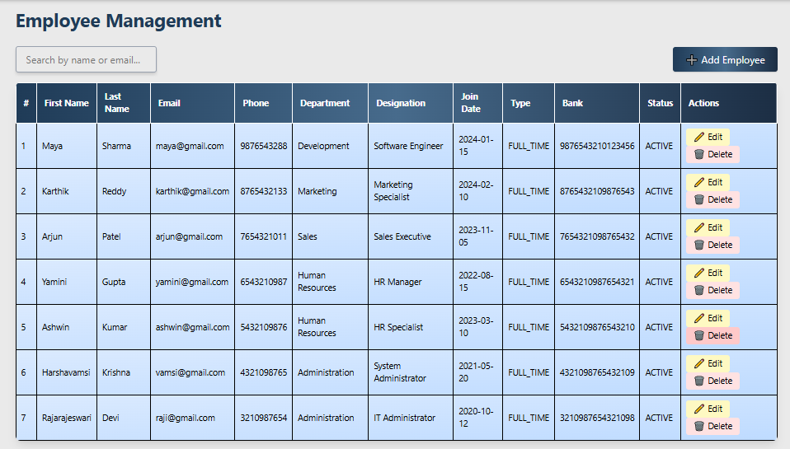
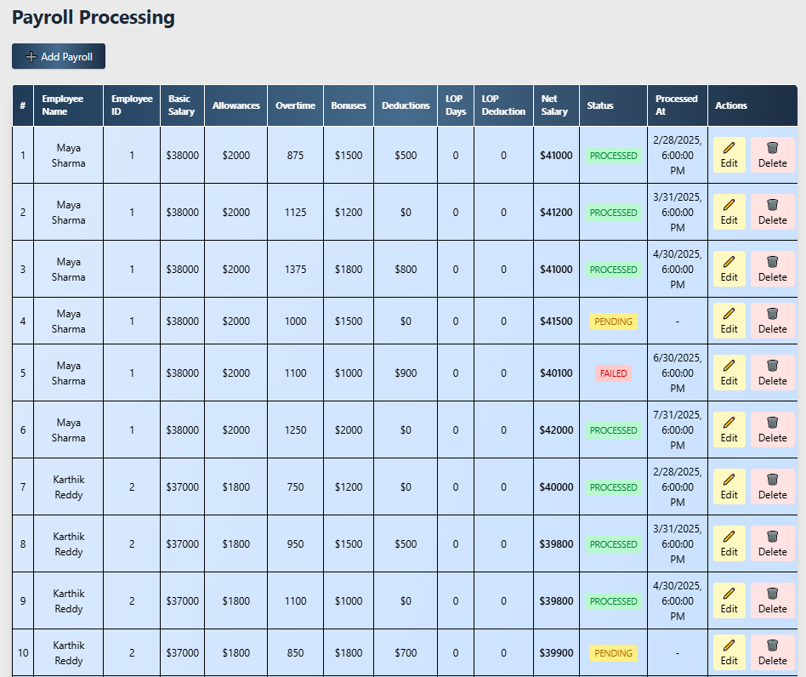
HR Components
Page 13

Slide 18
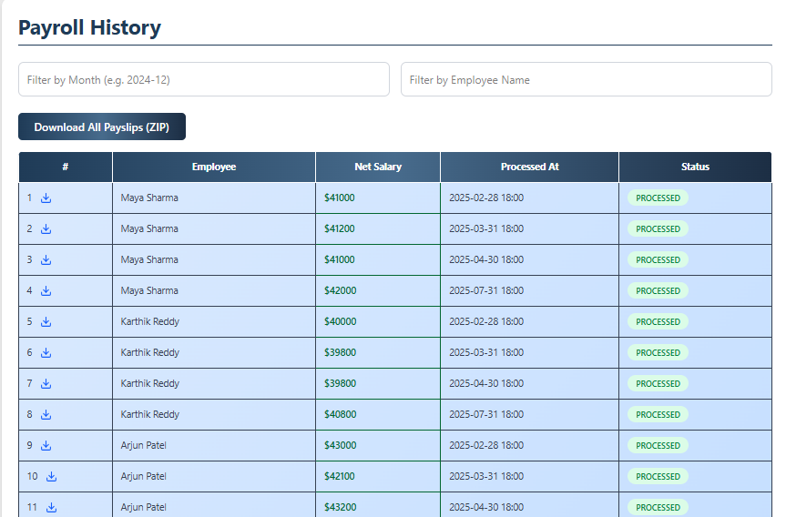
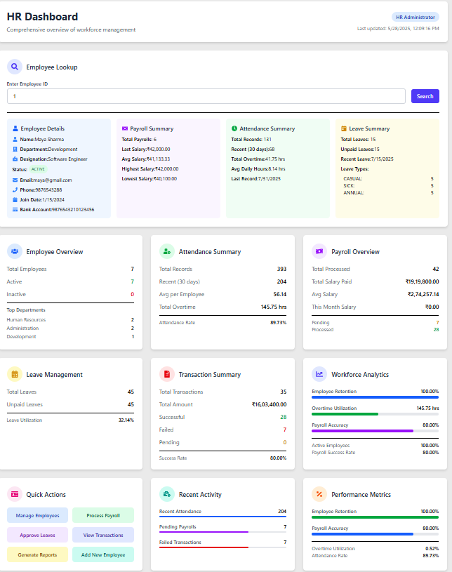
HR Components
Page 13

Slide 19
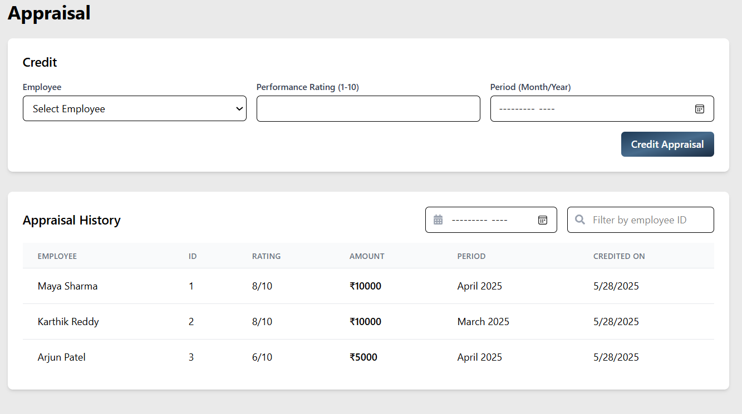
HR Components
Page 13

Slide 20
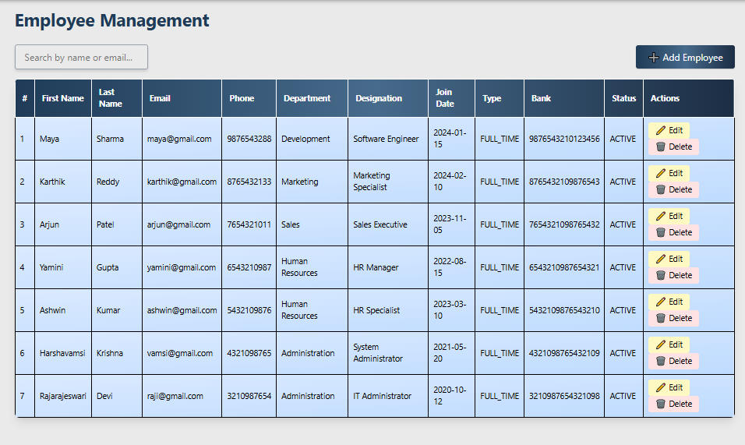
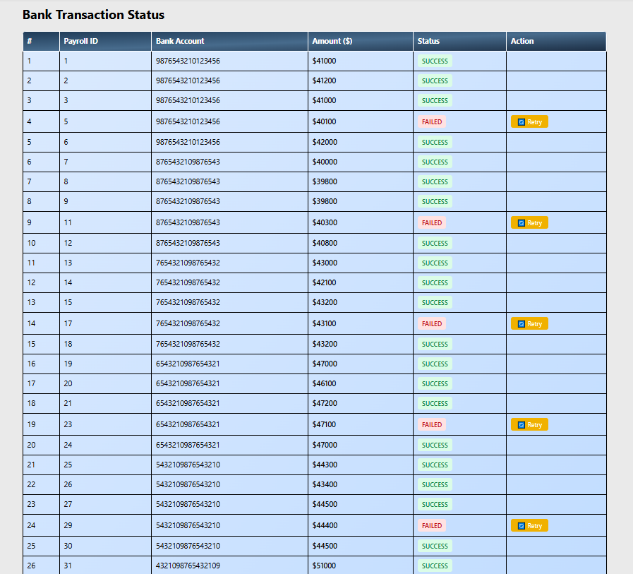
ADMIN COMPONENTS
Page 13
Leave records

Slide 21
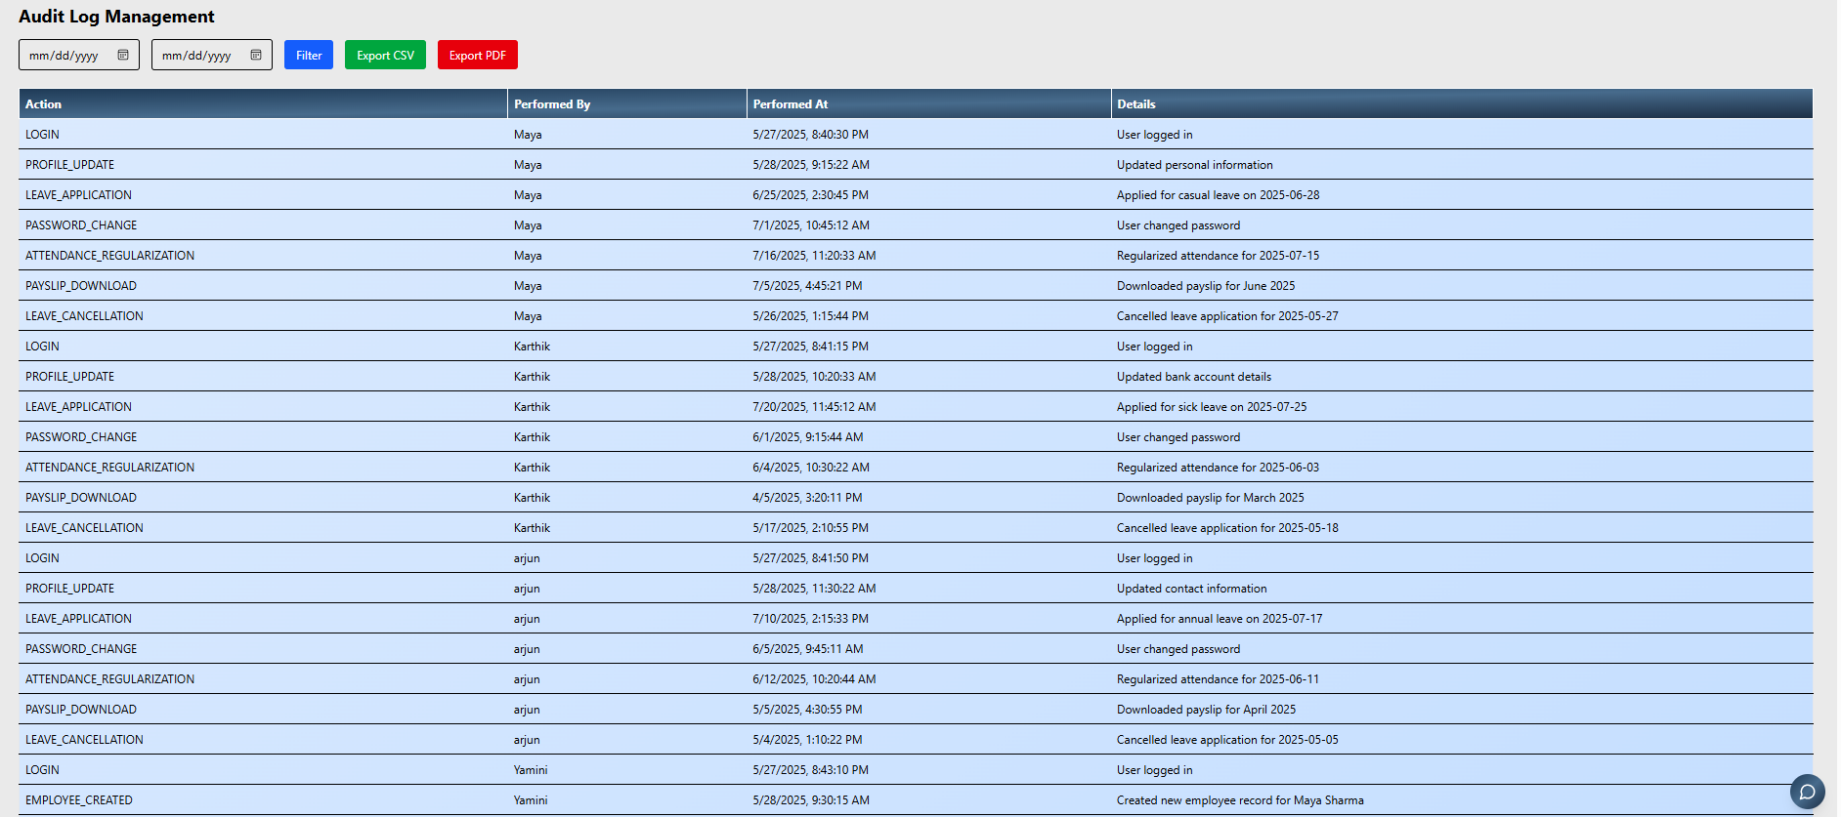
ADMIN COMPONENTS
Page 13
Leave records

Slide 22
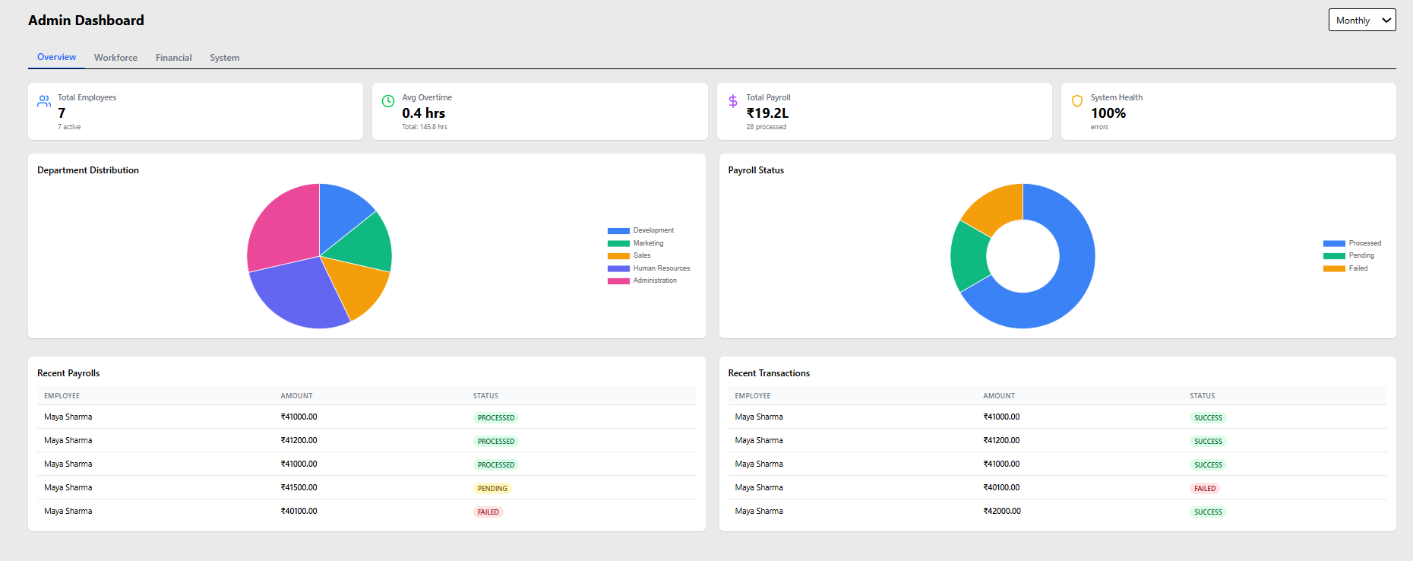
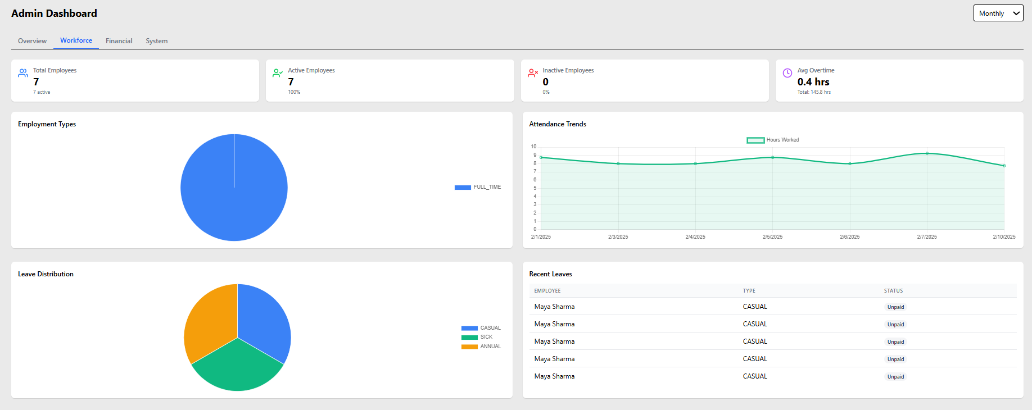
ADMIN COMPONENTS
Page 13
Leave records

Slide 23
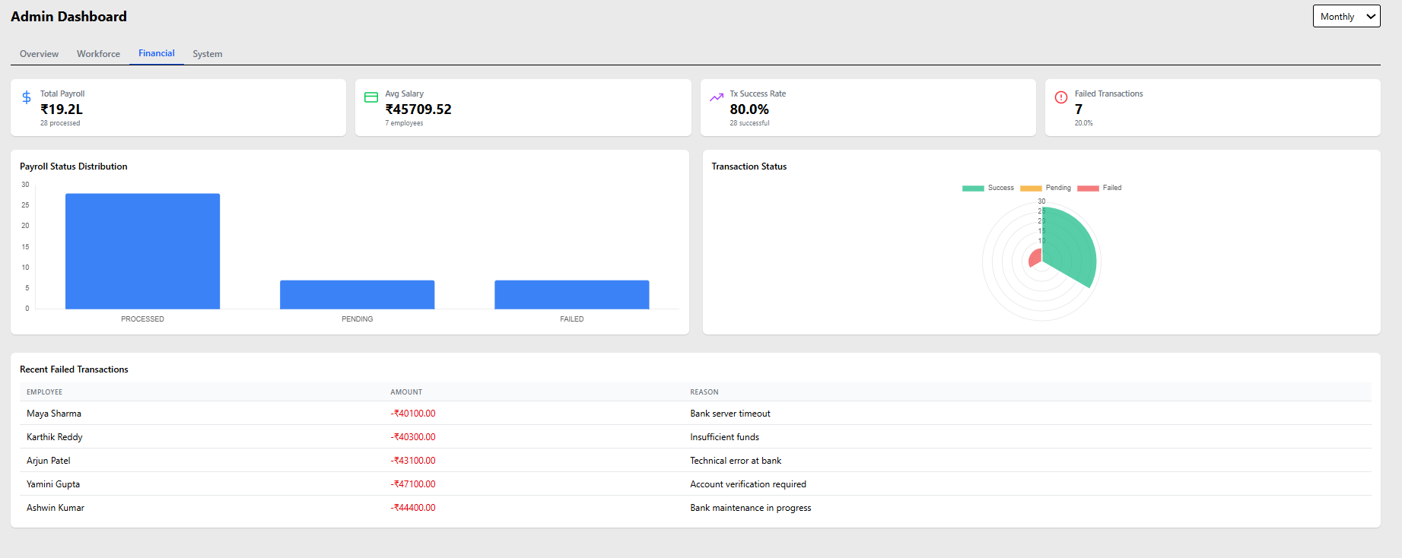
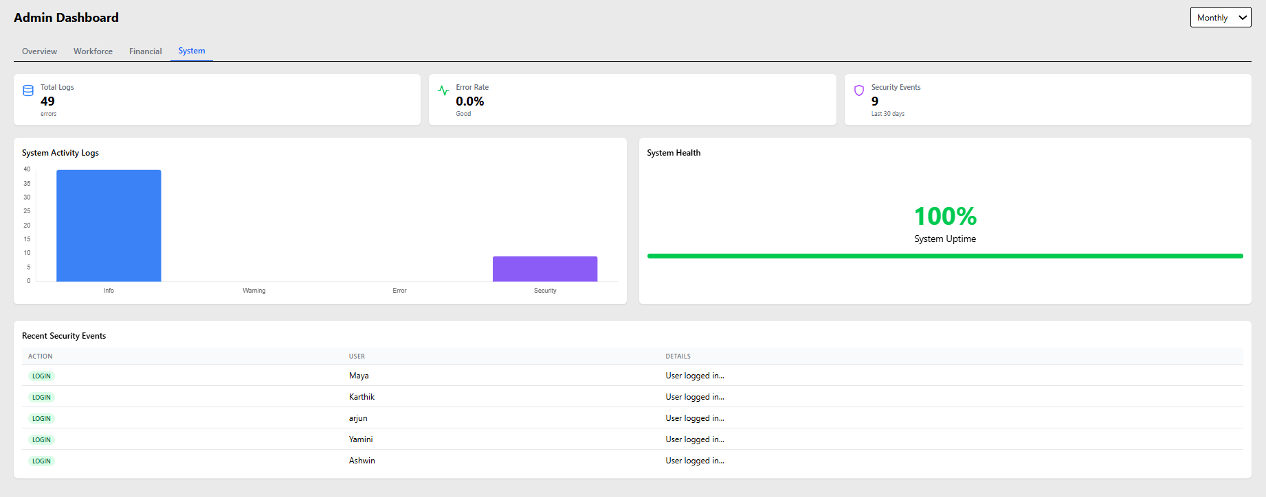
ADMIN COMPONENTS
Page 13
Leave records

Slide 24
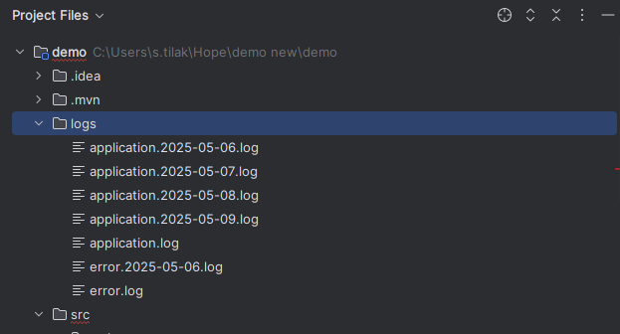
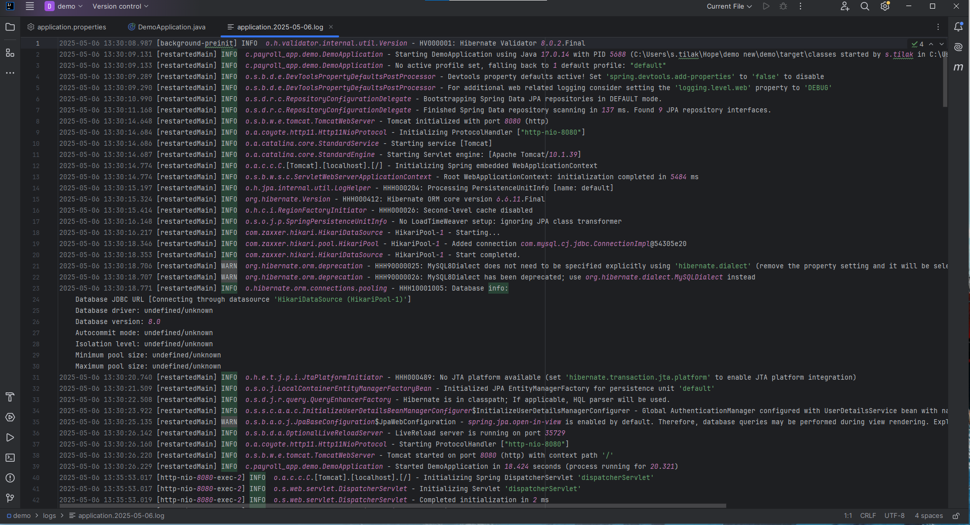
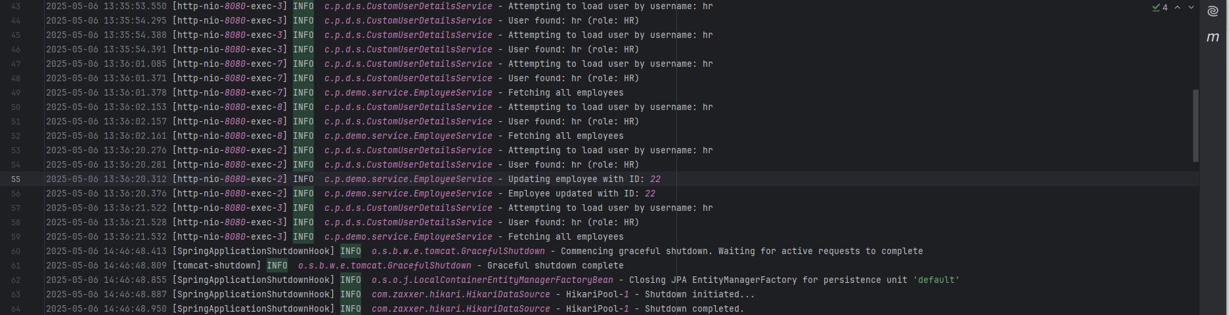
Admin Component (Logs) :
Page 14

Slide 25
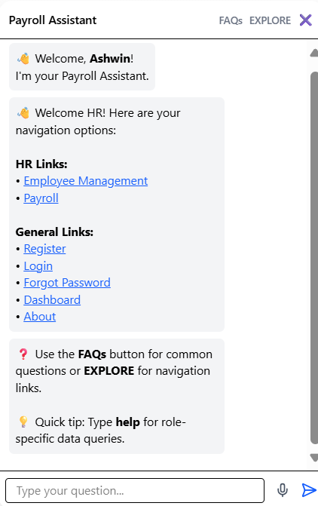
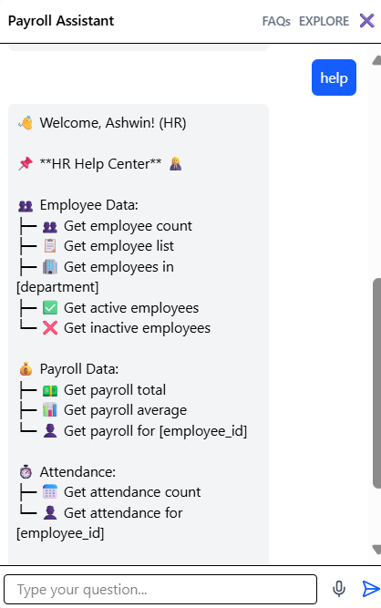
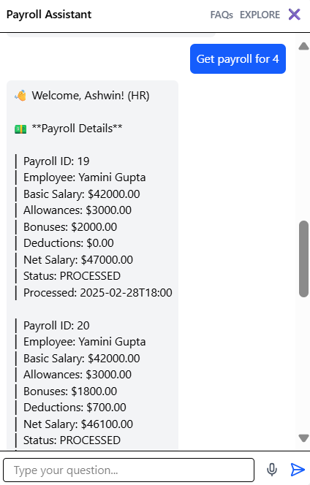
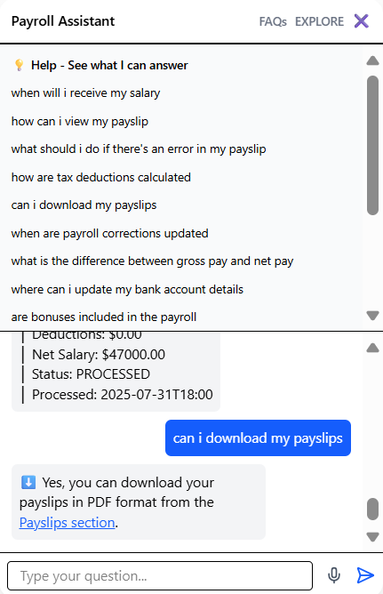
UI COMPONENTS
Chatbot Components :
Page 14

Slide 26
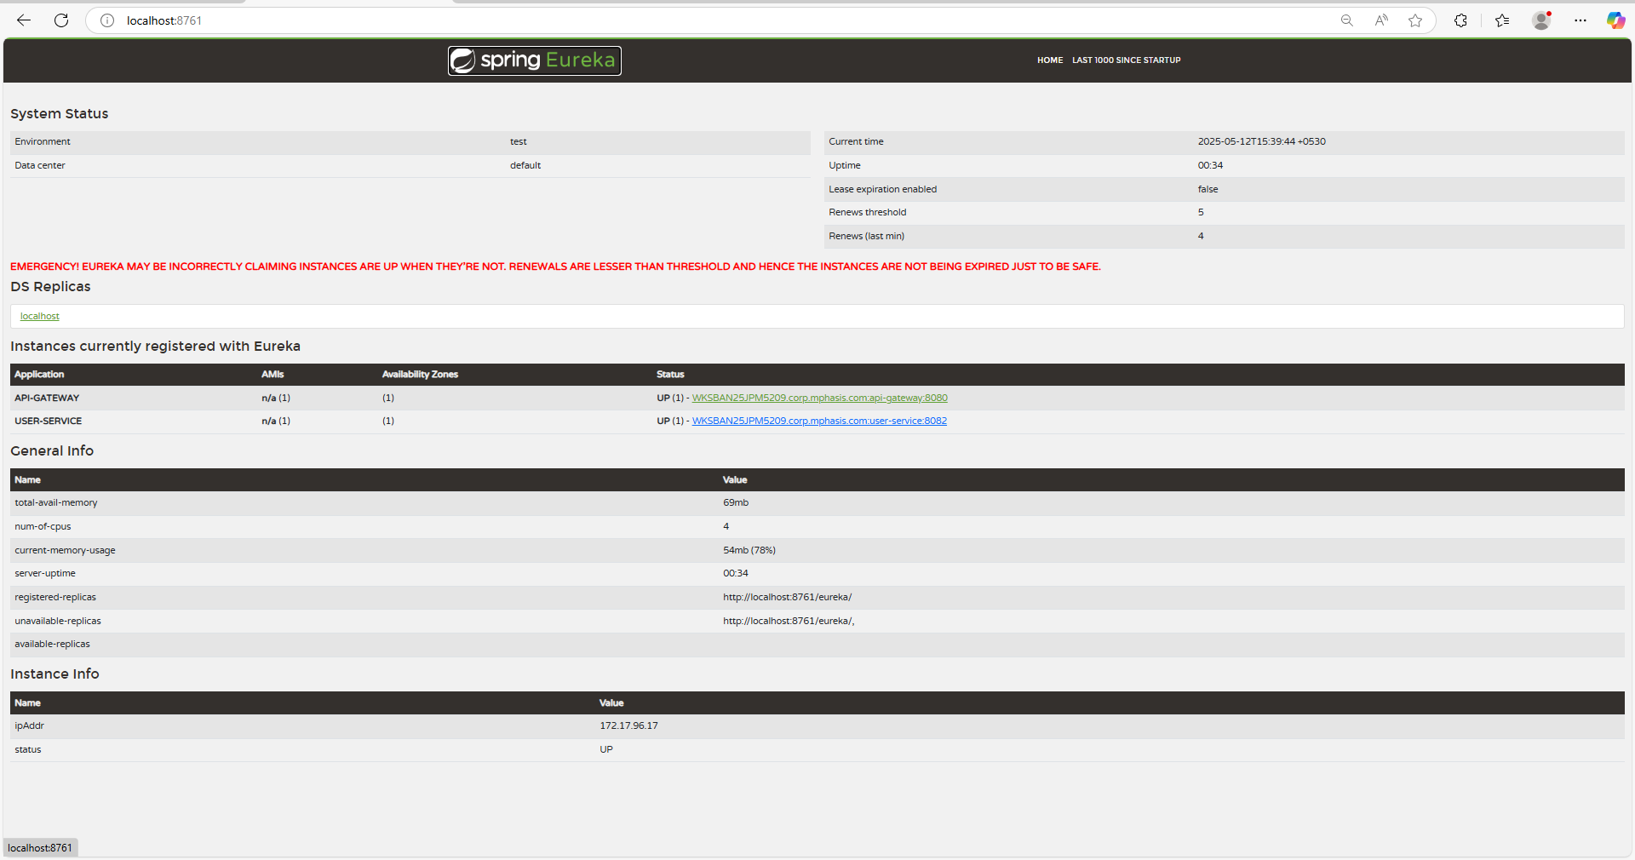
UI COMPONENTS
Microservice Components :
Page 14

Slide 27
THANK YOU!!

